Slide 1



FRAUD AND DETECTION TECHNOLOGIES
Academic Perspectives on Data Analysis for Fraud Prevention

Slide 2
Agenda
Data Analysis Overview
Common Analysis Procedures
Types of Data Analysis
OLAF Approach
Continuous Monitoring

Slide 3
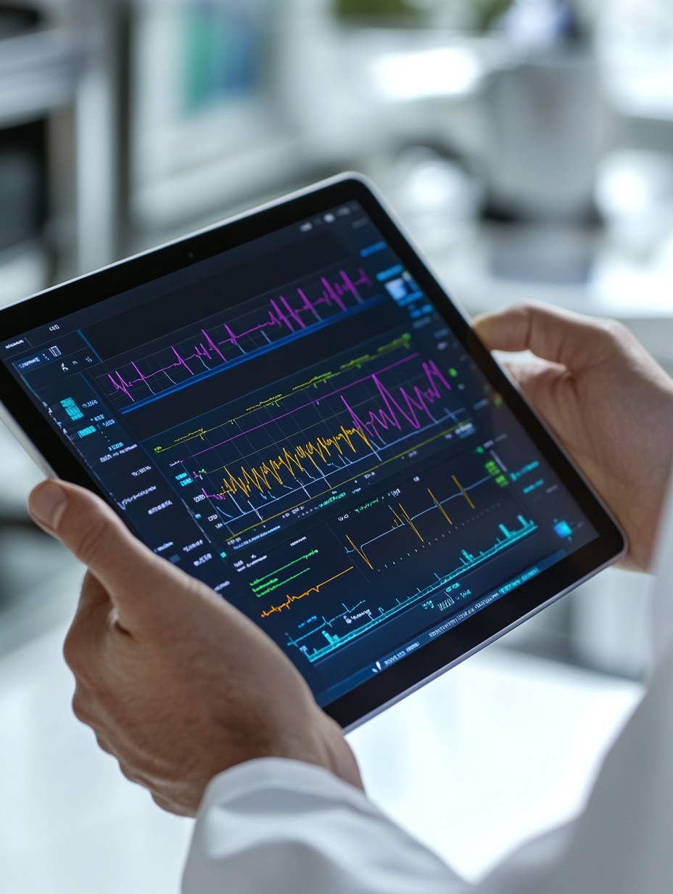
DATA ANALYSIS-OVERVIEW
Data analysis involves the systematic application of statistical and computational techniques to uncover patterns, anomalies, and relationships within datasets that may indicate fraudulent activity and support decision making. This process is crucial for identifying red flags and building predictive models to mitigate financial and operational risks.
Data analysis: Conditional probability helps interpret complex data and detect fraud.

Slide 4
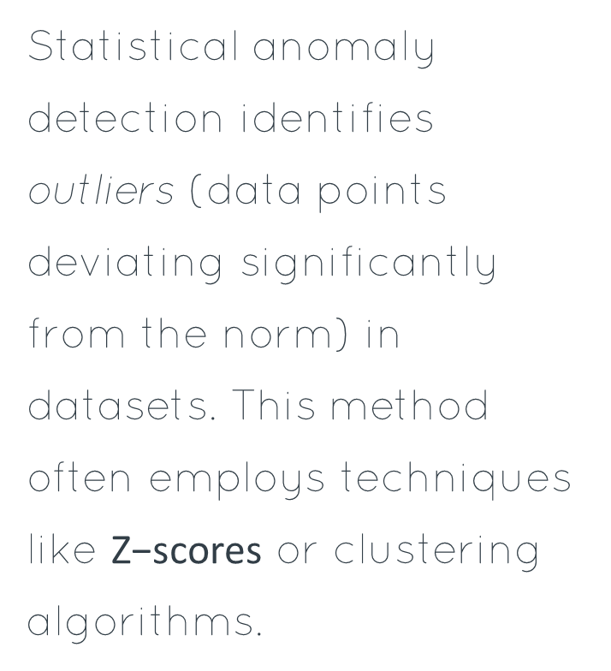
COMMON ANALYSIS PROCEDURES
Statistical Anomaly Detection
Machine Learning Classifiers
Network Analysis
Network analysis examines relationships between entities, like individuals or accounts, to uncover suspicious structures. It identifies fraud rings (groups collaborating in fraudulent activities) and complex schemes.
Statistical anomaly detection identifies outliers (data points deviating significantly from the norm) in datasets. This method often employs techniques like $\text{Z}\text{−}\text{scores}$ or clustering algorithms.
Machine learning classifiers, such as Support Vector Machines (SVMs), categorize transactions as fraudulent or legitimate. These models learn patterns from historical data to predict future outcomes.

Slide 5
TWO TYPES OF DATA ANALYSIS
Descriptive Analytics
Predictive and Prescriptive Analytics
Descriptive analytics examines historical data to understand past events. It answers "What happened?" by summarizing trends and patterns, such as identifying common fraud schemes or transaction anomalies. Techniques include data aggregation (combining data from multiple sources) and visualization, providing insights into existing fraud landscapes.
Predictive analytics uses statistical models and machine learning to forecast future outcomes, addressing "What will happen?" For example, it predicts the likelihood of future fraudulent activities. Prescriptive analytics then recommends actions to optimize outcomes, answering "What should we do?" to mitigate identified risks.

Slide 6
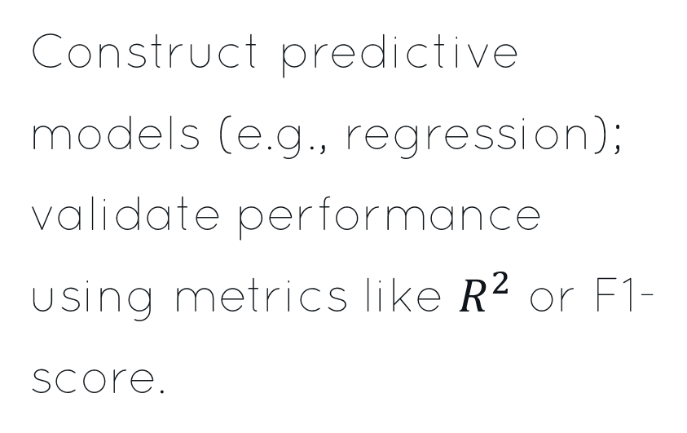
PERFORMING DATA ANALYSIS
1
2
3
Acquire & Refine Data
Explore Data Patterns
Model Development & Validation
Gather raw data; cleanse (remove errors) and transform (normalize) for analysis. Missing values often imputed.
Visualize distributions, identify outliers (anomalous data points), and assess variable relationships.
Construct predictive models (e.g., regression); validate performance using metrics like $R^{2}$ or F1-score.

Slide 7

PERFORMING DATA PROFILING
Data profiling systematically examines data to discover structure, content, and relationships, which is crucial for identifying anomalies and ensuring data quality. This process involves analyzing data attributes (e.g., value ranges, uniqueness) to establish baselines for fraud detection.
Analyzing agricultural and manufacturing data, essential for advertising strategies.

Slide 8
Contextual Analysis
Contextual analysis examines the environmental factors, such as socio-economic conditions or regulatory changes, that influence individual and organizational behavior. This involves assessing the broader landscape in which potential fraud might occur.
PERFORMING CONTEXTUAL AND BEHAVIOUR QUALITATIVE ANALYSIS
Qualitative Interpretation
Qualitative interpretation synthesizes contextual and behavioral insights to formulate comprehensive fraud hypotheses. This process often employs inductive reasoning, moving from specific observations to general conclusions.
Behavioral Analysis
Behavioral analysis focuses on identifying anomalous patterns or deviations from typical actions. This involves scrutinizing user interactions and transaction histories to detect suspicious activities.

Slide 9
OLAF APPROACH IN DATA ANALYSIS
1
2
3
4
Obtain Data
Link Data
Analyze Data
Feedback Loop
Gather diverse datasets (e.g., transactional, behavioral) from various sources.
Integrate disparate datasets, establishing relationships between entities (e.g., individuals, transactions).
Employ advanced analytical techniques (e.g., machine learning, statistical modeling) to detect anomalies.
Continuously refine models and strategies based on detection outcomes and new fraud patterns.

Slide 10
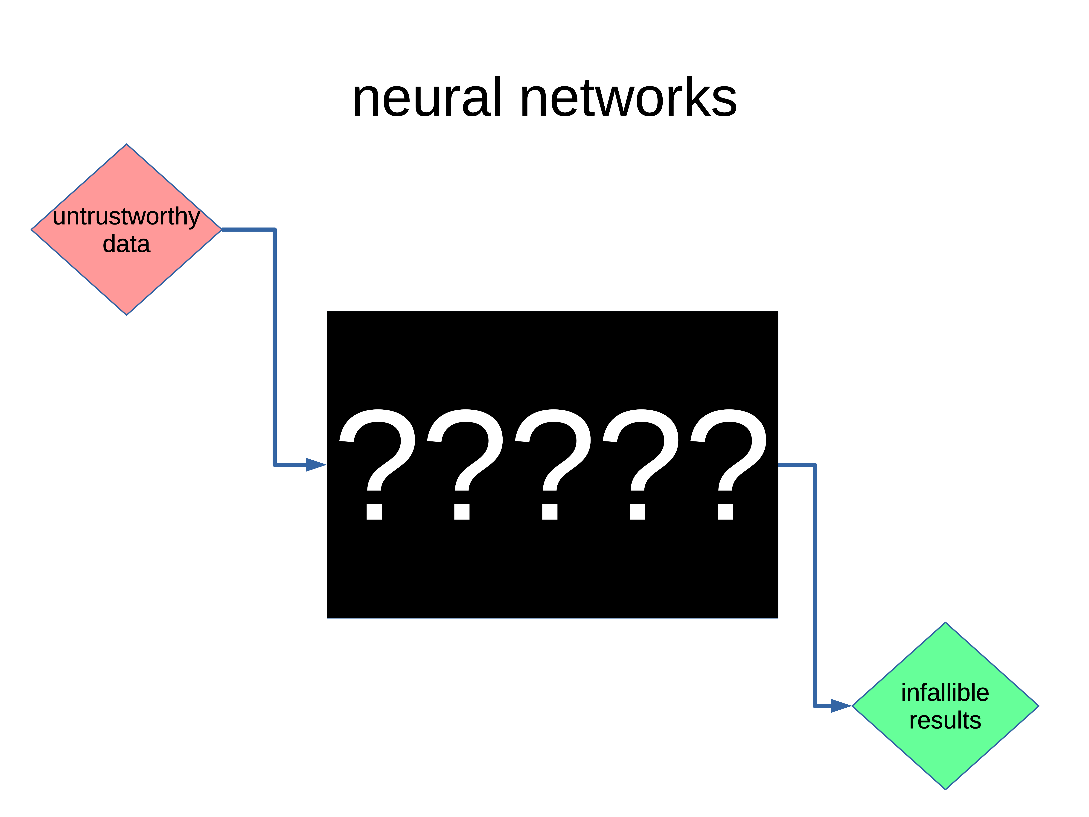
Successful Implementation of Data Analysis
Robust data governance (data management) is foundational.
Advanced machine learning (AI algorithms) models enhance detection.
Cross-functional collaboration (teamwork) ensures comprehensive insights.
Continuous model validation (performance monitoring) is essential.
Untrustworthy data leads to uncertain results in neural networks.

Slide 11

IMPLEMENTATION OF CONTINUOUS MONITORING AND SURVEILLANCE
Data Ingestion
Aggregating diverse data streams, such as transactional logs (records of system activities) and network traffic, for comprehensive analysis.
Real-time Analytics
Employing machine learning algorithms, like unsupervised learning (identifying patterns without prior labels), to detect anomalies instantaneously.
Automated Response
Orchestrating automated actions, such as flagging suspicious transactions or initiating user authentication challenges, upon anomaly detection.

Slide 12

Future of Fraud Detection: Beyond Current Paradigms?
Considering the evolving sophistication of financial crime, how can we proactively leverage emerging technologies like quantum computing (which uses quantum-mechanical phenomena such as superposition and entanglement to perform computations) or neuromorphic engineering (which designs hardware to mimic the brain's structure and function) to anticipate and neutralize novel fraud schemes before they materialize, moving beyond reactive data analysis and digital forensics?

Slide 13
Conclusion
Effective fraud detection necessitates sophisticated data analysis, moving beyond traditional auditing methods for comprehensive insights.
Data profiling and qualitative analysis are crucial for identifying anomalous patterns and behavioral red flags in complex datasets.
The OLAF approach provides a structured framework for robust data analysis in combating financial fraud effectively.
Successful implementation requires continuous monitoring and surveillance, integrating advanced technologies for proactive fraud prevention.

